Slide 1
Unit 5 Accounting principles LO1
Different branches of accounting
Financial Accounting:
Financial accounting involves recording and categorizing transactions for businesses. This data is generally historical, meaning it’s from the past. It also involves generating financial statements based on these transactions. All financial statements, such as a balance sheet and an income statement, must be prepared in a certain way. This tends to be according to the generally accepted accounting principles. These are known as GAAP for short. Financial accounting is performed to conform to external regulations. It is not for internal employees to analyze and make financial decisions—
2. Cost Accounting
Cost accounting is considered a type of managerial accounting. Cost accounting is most commonly used in the manufacturing industry, an industry that has a lot of resources and costs to manage. It is a type of accounting used internally to assess a company’s operations.
Cost accounting concerns itself with recording and analyzing manufacturing costs. It looks at a company’s fixed (unchanging and constant costs, like rent) and variable costs (changing costs, like shipping charges). Then it looks at how they affect a business, and how these costs can be better managed, according to Accounting Tools.

Slide 2
3. Auditing
helps a business zero in on fraud, mismanagement and waste. It also identifies and controls any potential weaknesses iThere are two types of auditing: external and internal auditing. In external auditing, an independent third party reviews a company’s financial statements. This is to make sure they are presented correctly and comply with GAAP.
Internal auditing involves evaluating how a business divides up accounting duties. As well as who is authorized to do what accounting task and what procedures and policies are in place. Internal auditing n its policies or procedures.
4. Managerial Accounting
This type of accounting provides data about a company’s operations to managers.
The focus of managerial accounting is to provide data. This is what managers need to make decisions about a business’s operations, not comply strictly with GAAP.
Managerial accounting includes budgeting and forecasting and cost analysis. As well as financial analysis, reviewing past business decisions and more.Cost accounting is a type of managerial accounting.

Slide 3
5 . Tax Accounting
Tax accounting involves planning for tax time and the preparation of tax returns. This branch of accounting aids businesses to be compliant with regulations set up by the IRS.
Tax accounting also helps businesses figure out their income tax and other taxes and how to legally reduce their amount of tax owing. Tax accounting also analyzes tax-related business decisions and any other issues related to taxes.
Forensic Accounting
Forensic accounting focuses on legal affairs. Such as inquiry into fraud, legal cases and dispute and claims resolution
Role of International Financial Reporting Standards (IFRS), risk management
IFRS or International Financial Reporting Standards refers to a globally-accepted set of accounting and financial reporting guidelines for preparing and presenting financial statements. It ensures uniformity in accounting practice that makes financial records comparable across different reporting entities worldwide. Issued by the International Accounting Standards Board (IASB), IFRS aims to make financial statements consistent, comparable, and transparent across the world. IFRS specifies how businesses need to maintain and report their accounts. Created to establish a common accounting language, the goal of the international financial reporting standards is to make financial statements coherent and consistent across different industries and countries. IFRS covers a broad range of topics, including revenue recognition, income taxes, inventories, fixed assets, business combinations, foreign exchange rates, and the presentation of financial statements.

Slide 4
There are many different IFRS standards that you need to pay attention to. Here are a couple of areas where IFRS provides comprehensive rules:
Statement of Financial Position – More commonly referred to as a balance sheet, IFRS details the different components and how it should be reported.
Statement of Comprehensive Income – This can be presented as a single statement or a profit and loss statement and a statement of other income.
Statement of Changes in Equity – Sometimes referred to as a statement of retained earnings, this should document your business’s change in profits over the course of a given financial period.
Statement of Cash Flow – This document should provide a summary of your business’s financial transactions over the given period, separating your cash flow into Financing, Operations, and Investing.
What is the difference between GAAP and IFRS?
The standards that are used to govern the rules of financial reporting can vary across countries. In the United States, these standards are grouped under GAAP (generally accepted accounting principles). However, in over 100 countries across the world, accounting standards are organized within the IFRS framework

Slide 5
LO2 what is Accounting
Accounting is the process of recording financial transactions pertaining to a business. The accounting process includes summarizing, analyzing, and reporting these transactions to oversight agencies, regulators, and tax collection entities.
Components of Basic Accounting
1. Recording
The primary function of accounting is to make records of all transactions that the firm enters into. For the purpose of recording, the accountant maintains a set of books. Their procedures are very systematic. Nowadays, the computer has been deployed to automatically account for transactions as they happen.
2 Summarizing
Summarizing refers to the preparation of a trial balance from the debit and credit balances of the ledger accounts.
3. Reporting
Management is answerable to the investors about the company’s state of affairs. The operations that are being financed with the money of owners, it needs to be periodically updated to them. For this reason, there are periodic reports annually summarising the performance of all four quarters which are sent to them.

Slide 6
Accounting Equation
The accounting equation is a basic principle of accounting and a fundamental element of the balance sheet. The equation is as follows:
Assets = Liabilities + Shareholder’s Equity
This equation sets the foundation of double-entry accounting, also known as double-entry bookkeeping, and highlights the structure of the balance sheet. Double-entry accounting is a system where every transaction affects at least two accounts.
What are the 5 steps of the accounting cycle?
Step 1: Analyze and record transactions.
Step 2: Post transactions to the ledger.
Step 3: Prepare an unadjusted trial balance.
Step 4: Prepare adjusting entries at the end of the period.
Step 5: Prepare an adjusted trial balance.
Rearranging the Accounting Equation
The accounting equation can also be rearranged into the following form:
Shareholder’s Equity = Assets – Liabilities

Slide 7
Common Accounting Terms All Business Owners Should Know
Balance Sheet Terms
The Balance Sheet is one of the two most common financial statements produced by accountants. This section pertains to potentially confusing basic accounting terms that relate to the balance sheet.
1. Accounts Payable (AP)
Accounts Payable include all of the expenses that a business has incurred but has not yet paid. This account is recorded as a liability on the Balance Sheet as it is a debt owed by the company.
2. Accounts Receivable (AR)
Accounts Receivable include all of the revenue (sales) that a company has provided but has not yet collected payment on. This account is on the Balance Sheet, recorded as an asset that will likely convert to cash in the short-term.
3. Accrued Expense
An expense that been incurred but hasn’t been paid is described by the term Accrued Expense.
4. Asset (A)
Anything the company owns that has monetary value. These are listed in order of liquidity, from cash (the most liquid) to land (least liquid).

Slide 8
5. Balance Sheet (BS)
A financial statement that reports on all of a company’s assets, liabilities, and equity. As suggested by its name, a balance sheet abides by the equation <Assets = Liabilities + Equity>
6. Equity (E)
Equity denotes the value left over after liabilities have been removed. Recall the equation Assets = Liabilities + Equity. If you take your Assets and subtract your Liabilities, you are left with Equity, which is the portion of the company that is owned by the investors and owners.
7 Income Statement Terms
The Income Statement AKA Profit and Loss Statement is the second of the two common financial statements. These are the most common basic accounting terms used in reference with this reporting tool.
8. Cost of Goods Sold (COGS)
Cost of Goods Sold are the expenses that directly relate to the creation of a product or service. Not included in this category are those costs that are needed to run the business. An example of COGS would be the cost of Materials, or the Direct Labor to provide a service.
10 . Depreciation (Dep)
Depreciation is the term that accounts for the loss of value in an asset over time. Generally, an asset has to have substantial value in order to warrant depreciating it. Common assets to be depreciated are automobiles and equipment. Depreciation appears on the Income Statement as an expense and is often categorized as a “Non-Cash Expense” since it doesn’t have a direct impact on a company’s cash position.

Slide 9
Expense (Cost)
An Expense is any cost incurred by the business for generating revenue
Gross Margin (GM)
Gross Margin is a percentage calculated by taking Gross Profit and dividing by Revenue for the same period. It represents the profitability of a company after deducting the Cost of Goods Sold.
Revenue (Sales) (Rev)
Whatever the business earns is called revenue
Debit
A debit is an increase in an asset or expense account, or a decrease in a liability or equity account.
Credit
A credit is an increase in a liability or equity account, or a decrease in an asset or expense account.
Asset accounts (Examples: Cash, Accounts Receivable, Supplies, Equipment)
Liability accounts (Examples: Notes Payable, Accounts Payable, Wages Payable)
Stockholders' Equity accounts (Examples: Common Stock, Retained Earnings)
Income Statement accounts:
Revenue accounts (Examples: Service Revenues, Investment Revenues)
Expense accounts (Examples: Wages Expense, Rent Expense, Depreciation Expense)

Slide 10
4 Types of Legal Structures for Business:
Sole Proprietorship
A type of business entity that is owned and run by one individual – there is no legal distinction between the owner and the business. Sole Proprietorships are the most common form of legal structure for small businesses.
Taxation: A sole Proprietorship has pass-through taxation. The business itself does not file a tax return. Instead, the income (or loss) passes through and is reported on the owner’s personal tax return
Liability: The Owner of the sole proprietorship has unlimited personal liability for any liabilities the business incurs. You can mitigate this risk with insurance and sound contracts.
Formation: The sole proprietorship is the simplest way of doing business. The costs to create a sole proprietorship are very low and very little formality is required.
Pros of a Sole Proprietorship: • Easy and fairly cheap to establish. • Owner has absolute control over the business.
Cons of a Sole Proprietorship: • Owner has unlimited personal exposure to risk, as the owner is responsible for all liabilities incurred by the business. • Investors typically would not invest in a business organized as a sole proprietorship.

Slide 11
Limited Liability Company (LLC)
A hybrid between a corporation, general partnership, and sole proprietorship. Owners of an LLC are called members. Members may include individuals, corporations, other LLCs and foreign entities. Most states permit an LLC with only one owner, called a “single member LLC.”
Taxation: An LLC is considered a “pass through entity” for tax purposes. This means, business income passes through the business to LLC members who report their share of profits or losses on their individual income tax returns. The LLC entity is only required to file an informational tax return, similar in character to the general partnership.
Liability: LLC members are protected from personal liability for business debts and claims, a feature known as “limited liability.” If a business with limited liability owes money or faces a lawsuit, only the assets of the business itself are at risk. Creditors can’t reach personal assets of the LLC members, except in cases of fraud or illegality. LLC members should exercise caution so that they don’t “pierce the corporate veil,” which would expose members to personal liability. For example, LLC owners should not use a personal checking account for business purposes, and should always use the LLC business name (rather than owner’s individual names) when working with customers.
Pros of LLC Structure: • Owners have limited liability, meaning that the entity is responsible for all liabilities the company incurs. • Profits and losses of company are passed on to the member and are only taxed at the individual level. • Allows an unlimited number of members
Cons of LLC Structure: • Often subject to additional taxes at the state level. • Each member’s share of profit represents taxable income, even if the profit wasn’t distributed.

Slide 12
4. Corporations
Corporations are the most complex business structure. A corporation is a legal entity that is separate and independent from the people who own or run the corporation, namely shareholders. A corporation has the ability to enter into contracts separate from that of the shareholders, but it also has certain responsibilities such as the payment of taxes. Corporations are generally more appropriate for larger established companies with multiple employees or when other factors apply (i.e. corporation sells a product or provides a service that could expose the business to sizable liability). Ownership is designated by issuing shares of stock.
Taxation (C-Corp): For federal income tax purposes, a C-Corp is recognized as a separate taxpaying entity, thus the entity files its own tax return (Form 1120). A c-corporation is subject to corporate income tax on any corporate profits (entity pays taxes). Shareholders pay personal income tax on the corporate profits distributed by the corporation to the owners.
Liability: Corporation shareholders have limited liability as they are not personally liable for debts and obligations incurred by the company. Shareholders cannot lose more money than the amount they invested in the corporation.
Pros of Corporations: • Corporate shareholders have limited liability, meaning the entity is responsible for all liabilities the company incurs. • Usually a favorable formation for investors.
Cons of Corporations: • The process to establish the business is more rigorous and costly. • Earnings are subject to “double taxation”, meaning that earnings are taxed at the entity level and the individual level upon distribution to shareholders. • High level of governance and oversight by the board of directors.

Slide 13
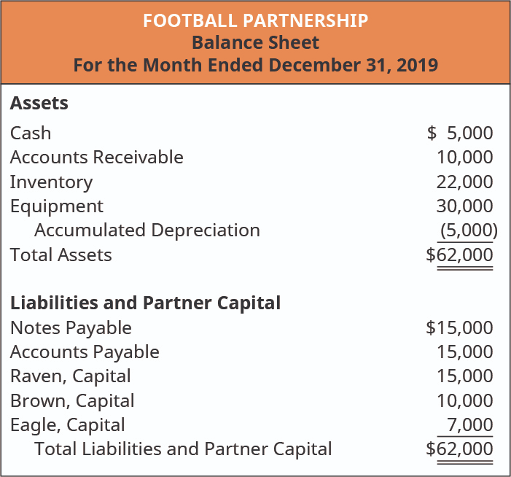
Format of balance sheet of partnership

Slide 14
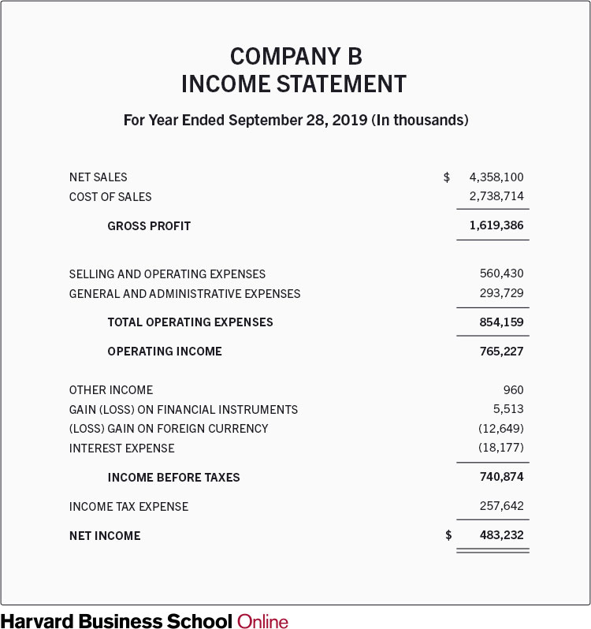
Income statement of Partnership is similar to a limited company

Slide 15
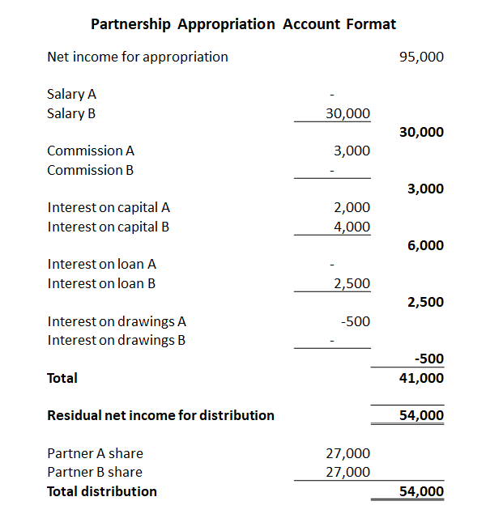
Appropriation account in partnership

Slide 16
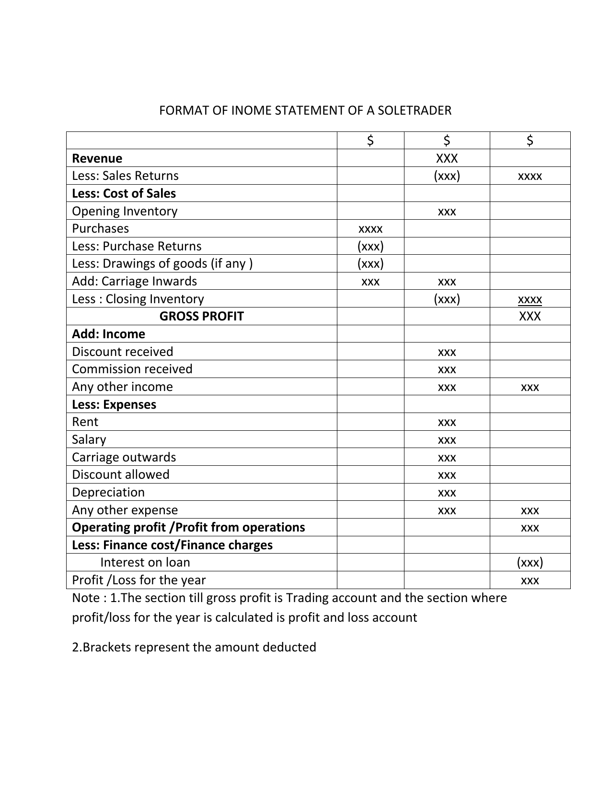
Format of Income statement of a sole trader

Slide 17


How to record transactions in a journal entry with Examples: Sole Proprietorship Transaction #1
Let's assume that J. Ott forms a sole proprietorship called Accounting Software Co. (ASC). On December 1, 2021, J. Ott invests personal funds of $10,000 to start ASC. The effect of this transaction on ASC's accounting equation is. As you can see, ASC's assets increase by $10,000 and so does ASC's owner's equity. As a result, the accounting equation will be in balance. You can interpret the amounts in the accounting equation to mean that ASC has assets of $10,000 and the source of those assets was the owner, J. Ott. Alternatively, you can view the accounting equation to mean that ASC has assets of $10,000 and there are no claims by creditors (liabilities) against the assets. As a result, the owner has a claim for the remainder or residual of $10,000. This transaction is recorded in the asset account Cash and the owner's equity account J. Ott, Capital. The general journal entry to record the transaction in these accounts is:

Slide 18


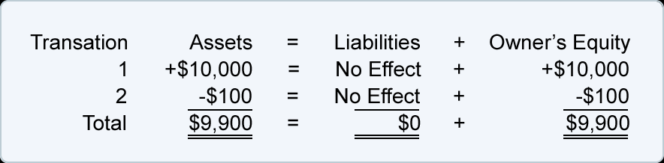
Sole Proprietorship Transaction #2.
On December 2, 2021, J. Ott withdraws $100 of cash from the business for his personal use. The effect of this transaction on ASC's accounting equation is:

Slide 19

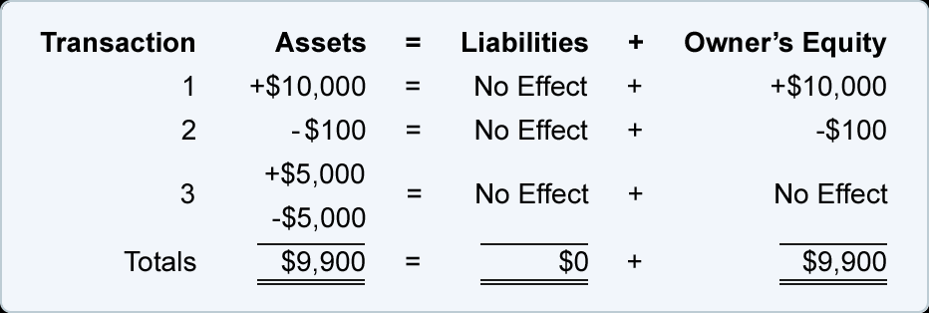
Sole Proprietorship Transaction 3
On December 3, 2021, Accounting Software Co. spends $5,000 of cash to purchase computer equipment for use in the business. The effect of this transaction on the accounting equation is: The accounting equation reflects that one asset increases and another asset decreases. Since the amount of the increase is the same as the amount of the decrease, the accounting equation remains in balance.This transaction is recorded in the asset accounts Equipment and Cash. The Equipment account increases by $5,000, and the Cash account decreases by $5,000. The journal entry for this transactions
The totals tell us that the company has assets of $9,900 and the source of those assets is the owner of the company. It also tells us that the company has assets of $9,900 and the only claim against those assets is the owner's claim

Slide 20
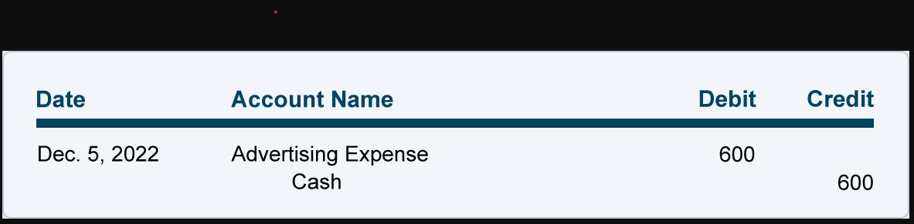
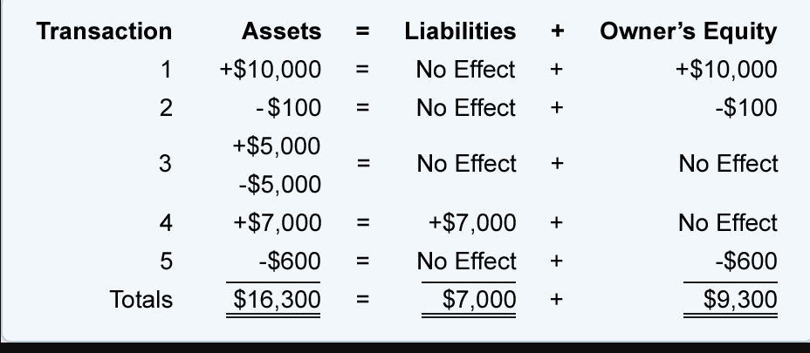
Sole Proprietorship Transaction #5.
On December 5, 2022, Accounting Software Co. pays $600 for ads that were run in recent days. The effect of this advertising transaction on the accounting equation is:
Since ASC is paying $600, its assets decrease. The second effect is a $600 decrease in owner's equity, because the transaction involves an expense. (An expense is a cost that is used up or its future economic value cannot be measured.)Although owner's equity is decreased by an expense, the transaction is not recorded directly into the owner's capital account at this time. Instead, the amount is initially recorded in the expense account Advertising Expense and in the asset account Cash.
The general journal entry to record the transaction is:

Slide 21
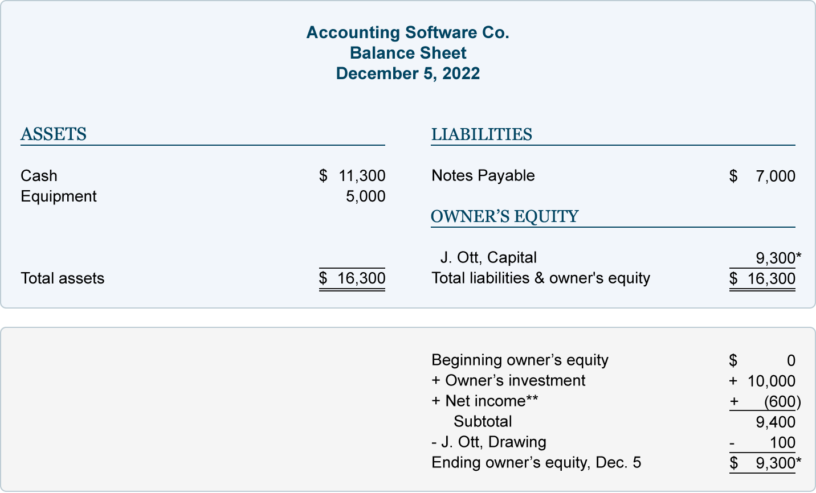
The totals now indicate that Accounting Software Co. has assets of $16,300. The creditors provided $7,000 and the owner of the company provided $9,300. Viewed another way, the company has assets of $16,300 with the creditors having a claim of $7,000 and the owner having a residual claim of $9,300. The balance sheet as of midnight on December 5 is:

Slide 22
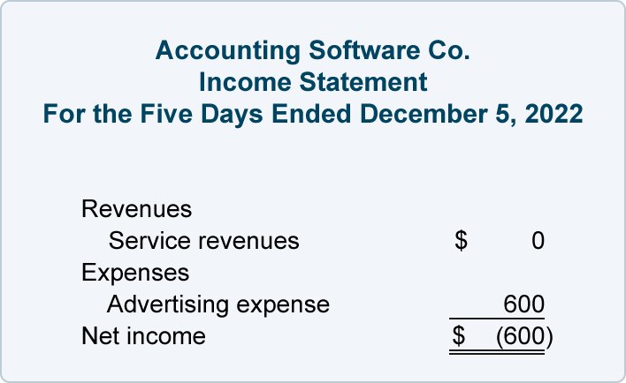
Since this transaction involves an expense, it will involve ASC's income statement. The company's income statement for the first five days of December is:

Slide 23


Sole Proprietorship Transaction #6.
On December 6, 2022, ASC performed consulting services for its clients. The clients were billed for the agreed upon amount of $900. The amounts are to be paid within 30 days. The effect on ASC's accounting equation is:
Since ASC has performed the services, it has earned revenues and it has the right to receive $900 from the clients. This right (known as an account receivable) causes assets to increase. The earning of revenues causes owner's equity to increase. Although revenues cause owner's equity to increase, the revenue transaction is not recorded into the owner's capital account at this time. Rather, the amount earned is recorded in the revenue account Service Revenues. This will allow the company to report the revenues on its income statement at any time. (After the year ends, the amount in the revenue accounts will be transferred to the owner's capital account.)
The general journal entry to record the transaction is:

Slide 24
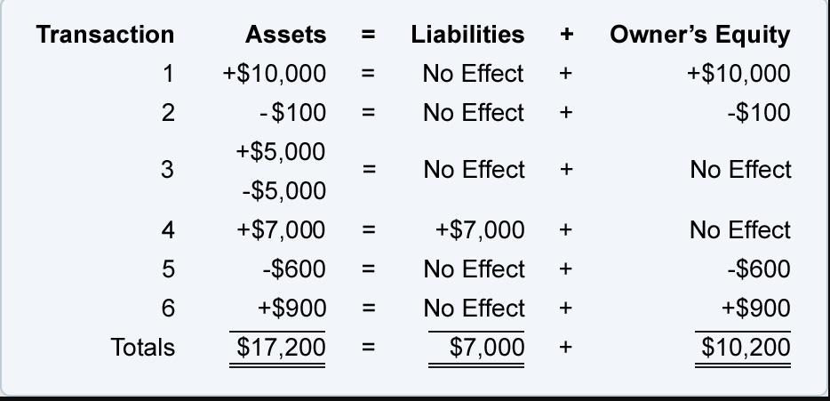
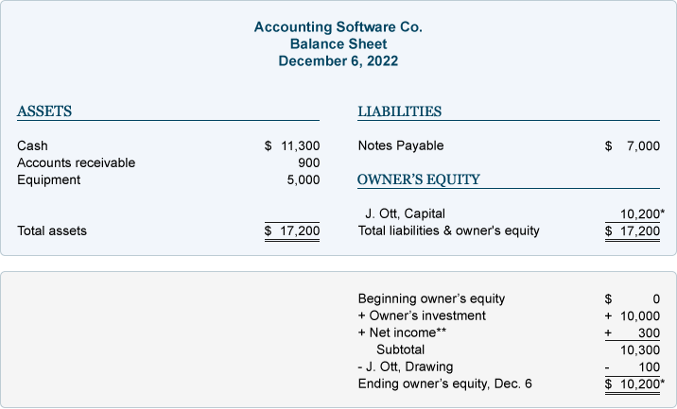
The combined effect of the first six transactions can be viewed here:
The totals tell us that as of midnight on December 6, the company had assets of $17,200. It also shows the sources of the assets: creditors provided $7,000 and the owner of the company provided $10,200. The totals also reveal that the company had assets of $17,200 and the creditors had a claim of $7,000 and the owner had a claim for the remaining $10,200.

Slide 25
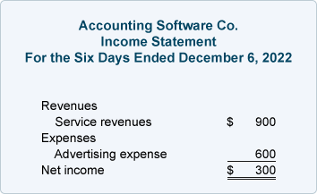
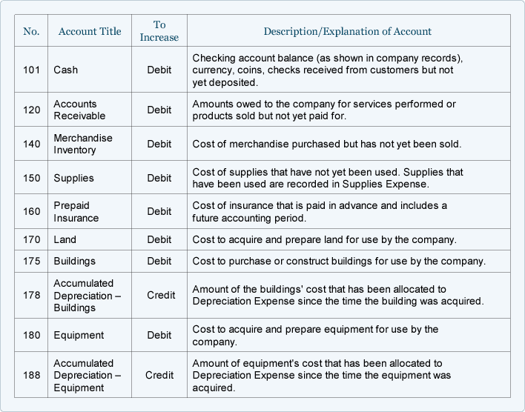
The Income Statement for Accounting Software Co. for the period of December 1 through December 6 is:
Sample Chart of Accounts for a Small Company
Asset Accounts

Slide 26
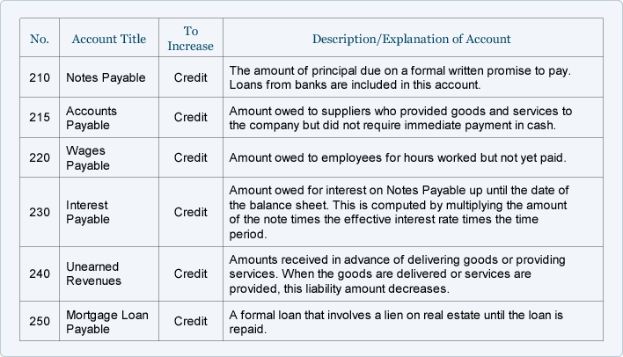
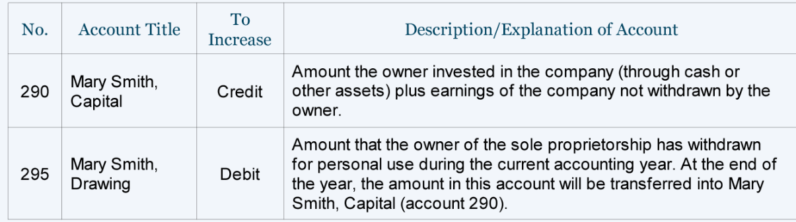
Liability Accounts
Owner's Equity Accounts

Slide 27
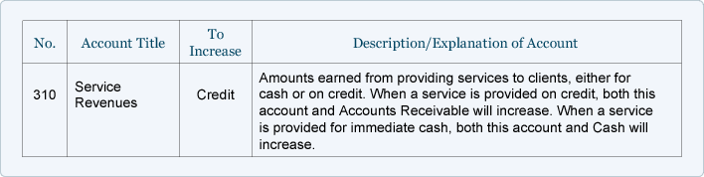
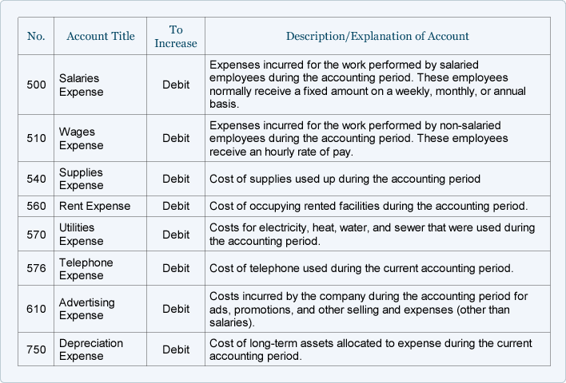
Operating Revenue Accounts
Operating Expense Accounts

Slide 28
Introduction to Adjusting Entries
Adjusting entries are accounting journal entries that convert a company's accounting records to the accrual basis of accounting. An adjusting journal entry is typically made just prior to issuing a company's financial statements.
To demonstrate the need for an accounting adjusting entry let's assume that a company borrowed money from its bank on December 1, 2022 and that the company's accounting period ends on December 31. The bank loan specifies that the first interest payment on the loan will be due on March 1, 2023. This means that the company's accounting records as of December 31 do not contain any payment to the bank for the interest the company incurred from December 1 through December 31. (Of course the loan is costing the company interest expense every day, but the actual payment for the interest will not occur until March 1.).
For the company's December income statement to accurately report the company's profitability, it must include all of the company's December expenses—not just the expenses that were paid. Similarly, for the company's balance sheet on December 31 to be accurate, it must report a liability for the interest owed as of the balance sheet date. An adjusting entry is needed so that December's interest expense is included on December's income statement and the interest due as of December 31 is included on the December 31 balance sheet. The adjusting entry will debit Interest Expense and credit Interest Payable for the amount of interest from December 1 to December 31.
Another situation requiring an adjusting journal entry arises when an amount has already been recorded in the company's accounting records, but the amount is for more than the current accounting period. To illustrate let's assume that on December 1, 2022 the company paid its insurance agent $2,400 for insurance protection during the period of December 1, 2022 through May 31, 2023. The $2,400 transaction was recorded in the accounting records on December 1, but the amount represents six months of coverage and expense. By December 31, one month of the insurance coverage and cost have been used up or expired. Hence the income statement for December should report just one month of insurance cost of $400 ($2,400 divided by 6 months) in the account Insurance Expense. The balance sheet dated December 31 should report the cost of five months of the insurance coverage that has not yet been used up. (The cost not used up is referred to as the asset Prepaid Insurance. The cost that is used up is referred to as the expired cost Insurance Expense.) This means that the balance sheet dated December 31 should report five months of insurance cost or $2,000 ($400 per month times 5 months) in the asset account Prepaid Insurance. Since it is unlikely that the $2,400 transaction on December 1 was recorded this way, an adjusting entry will be needed at December 31, 2022 to get the income statement and balance sheet to report this accurately

Slide 29
The two examples of adjusting entries have focused on expenses, but adjusting entries also involve revenues. This will be discussed later when we prepare adjusting journal entries.
For now we want to highlight some important points.
There are two scenarios where adjusting journal entries are needed before the financial statements are issued:
Nothing has been entered in the accounting records for certain expenses or revenues, but those expenses and/or revenues did occur and must be included in the current period's income statement and balance sheet.
Something has already been entered in the accounting records, but the amount needs to be divided up between two or more accounting periods.
Adjusting entries almost always involve abalance sheet account (Interest Payable, Prepaid Insurance, Accounts Receivable, etc.) and an income statement account (Interest Expense, Insurance Expense, Service Revenues, etc.)

Slide 30
Types of Adjusting Entries
The amount of adjusting entries a business makes depends on their number of financial transactions. However, we divide adjusting entries into three main types: accruals, deferrals, and non-cash expenses.
Accruals
Accrued Revenue:
A business may earn revenue from selling a good or service during one accounting period, but not invoice the client or receive payment until a future accounting period. These earned but unrecognized revenues are adjusting entries recognized in accounting as accrued revenues.
You record accrued revenues by:
Debiting the accounts receivable account and,
Crediting the service revenue account.
Accrued Expense:
Another type of accrual in accounting is the accrued expense. Accrued expenses are expenses made but that the business hasn’t paid for yet, such as salaries or interest expense.
They are recorded as an adjusting entry by:
Debiting the expense account
And crediting accounts payable.

Slide 31
Deferrals
Prepaid Expenses:
When your business makes an expense that will benefit more than one accounting period, such as paying insurance in advance for the year, this expense is recognized as a prepaid expense.These prepayments are first recorded as assets, and as time passes by, they are expensed through adjusting entries.
The adjusting entry for prepaid expenses includes:
A debit to the expense account (insurance expense, for example) and a credit to prepaid expense account previously recorded.
Deferred revenue or Unearned Income:
The other deferral in accounting is the deferred revenue, which is an adjusting entry that converts liabilities to revenue.
More specifically, deferred revenue is revenue that a customer pays the business, for services that haven’t been received yet, such as yearly memberships and subscriptions.
When cash is received it’s recorded as a liability since it hasn’t been earned yet by the business. Over time, this liability is turned into revenue until it’s fully earned.
This change is done by recording the following adjusting entry:
Debiting the unearned revenue account
Crediting the service revenue account

Slide 32
Non-Cash Expenses
The most common method used to adjust non-cash expenses in business is depreciation.
By definition, depreciation is the allocation of the cost of a depreciable asset over the course of its useful life. Depreciable assets (also known as fixed assets) are physical objects a business owns that last over one accounting period, such as equipment, furniture, buildings, etc.
In simpler terms, depreciation is a way of devaluing objects that last longer than a year, so that they are expensed according to the time that they get used by the business (not when you pay for them).
For instance, if a company buys a building that’s expected to last for 10 years for $20,000, that $20,000 will be expensed throughout the entirety of the 10 years, rather than when the building is purchased.
And since depreciation doesn’t involve any actual cash exchange, it’s purely an estimate of how much a physical asset gets used in one accounting period. The most commonly used formula to estimate depreciation is by the straight-line method in which:the adjusting entry to record the depreciation expense includes:
A debit to the depreciation expense account
A credit to the accumulated depreciation account
Examples for Adjusting Entries
Now that we know the different types of adjusting entries, let’s check out how they are recorded into the accounting books.
For the sake of our example, Company XYZ adjusts their accounts at the end of every month through the double-entry bookkeeping method. For the month of December, this is the information available to prepare adjusting entries

Slide 33
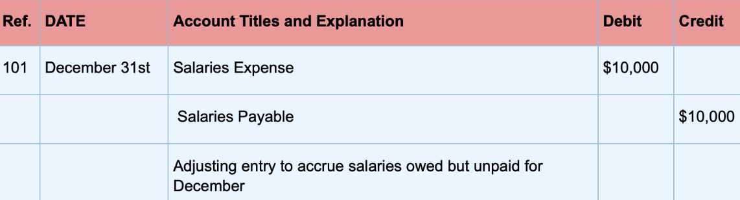
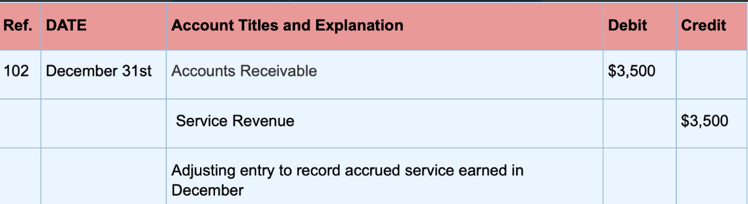
1. Salaries earned by the HR department employees that haven’t been recorded or paid yet, amount to $10,000. This is an accrued expense for which the following adjusting entry is made:
2. At the beginning of December, the company provided $3,500 worth of service that the customer will pay for next month. To record this accrued revenue, the resulting adjusting entry is made:

Slide 34
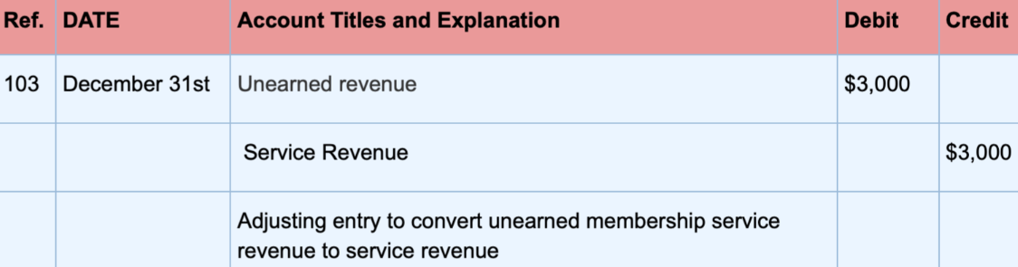
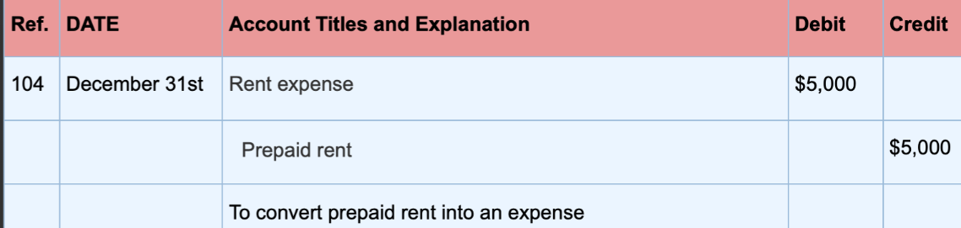
3. $3,000 of previously unearned fees from memberships in November have been earned. To convert this liability into revenue the following adjusting entry gets made:
4. The company pays rent for their offices in advance on a quarterly basis for $15,000. For the month of December, rent expense would be $5,000 ($15,000/3 months). The following adjusting entry is made to convert prepaid rent for the month of December into an expense:

Slide 35
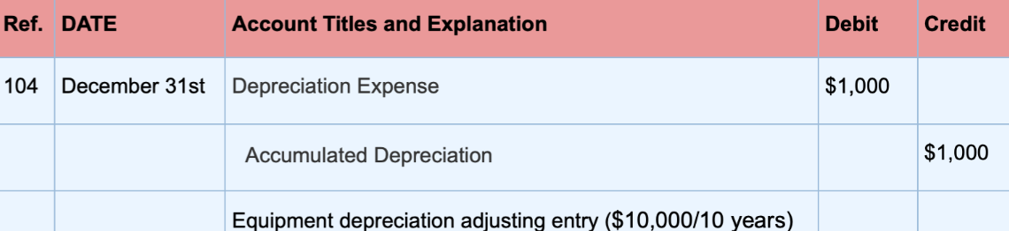
5. The original cost of the company’s equipment was $10,000, with an estimated 10-year life. Depreciation is recorded annually with the straight-line method, so on December 31st, the depreciation expense would be $1,000 ($10,000/10 years):

Slide 36
Second step of accounting is to post journal entries in general Ledger
Journal entries: Example
Your rent is $1,500 per month. Your journal entry would look something like this:
Date | Account | Debit | Credit
23 June 2022 | Rent expense | 1500
 | Cash |  | 1500
How to post journal entries to the general ledger
After you record transactions in your journal, it’s time to transfer them to your general ledger. To keep your books accurate, post every transaction from your journal to your general ledger.
Use your ledger to classify and organize transactions. When posting entries to the ledger, move each journal entry into an individual account
When posting journal entries to your general ledger, do not change any information. For example, if you debit an account in a journal entry, debit the same account in your ledger.
Keep in mind that your general ledger lists all the transactions in a single account. This allows you to know the balance of each account. But to find the balance, you need to do some math. After posting entries to the ledger, calculate the following balances:

Slide 37
Asset and expense accounts: Subtract total credits from total debits
Liabilities, equity, and revenue accounts: Subtract total debits from total credits
At the end of each period (e.g., month), transfer journal entries into your ledger.
Ledger entries are separated into different accounts. The accounts, called T-accounts, organize your debits and credits for each account. There is a T-account for each category in your accounting journal.
Here’s an example of what your general ledger account may look like after posting journal entries:
On December 3, 2021, Accounting Software Co. spends $5,000 of cash to purchase computer equipment for use in the business
On December 5, 2022, Accounting Software Co. pays $600 for ads that were run in recent days. The effect of this advertising transaction on the accounting equation is

Slide 38
How to post journal entries to the general ledger: Example
To keep your records accurate, you should post to the general ledger as you make transactions. At the end of each period (e.g., month), transfer journal entries into your ledger.
Ledger entries are separated into different accounts. The accounts, called T-accounts, organize your debits and credits for each account. There is a T-account for each category in your accounting journal.
Cash Account
Date | Description | Debit | Credit
23 June 2022 | Rent expense |  | 1500
Dec 3,2022 | Equipment |  | 5000
Dec 5, 2022 | Advertising expense |  | 600
Subtotal |  | 0 | 7100
Total |  |  | 7100
The Subtotal row gives you details about the subtotals for your debits and credits. Because this is a Checking (asset) account, deduct the credits from your debits to get the account’s total balance.

Slide 39
Why are ledger entries important?
Posting entries to the general ledger helps you catch accounting mistakes in your records. Catching mistakes early on helps you steer clear of bigger problems down the road, like inaccurate financial reports and tax filings. Keeping your ledger up-to-date can help you avoid penalties and ensure that your records give you an accurate picture of your business’s finances.
Another Example of Balancing off accounts and preparing a trial balance
What is a trial balance?
A trial balance is a list of all the balances in the nominal ledger accounts. It serves as a check to ensure that for every transaction, a debit recorded in one ledger account has been matched with a credit in another. If the double entry has been carried out, the total of the debit balances should always equal the total of the credit balances. Furthermore, a trial balance forms the basis for the preparation of the main financial statements, the balance sheet and the profit and loss account.
How do we prepare a trial balance?
In order to prepare a trial balance, we first need to complete or ‘balance off ’ the ledger accounts. Then we produce the trial balance by listing each closing balance from the ledger accounts as either a debit or a credit balance. Below are the T-accounts in Edgar Edwards’ nominal ledger. We need to work out the balance on each of these accounts in order to compile the trial balance.

Slide 40
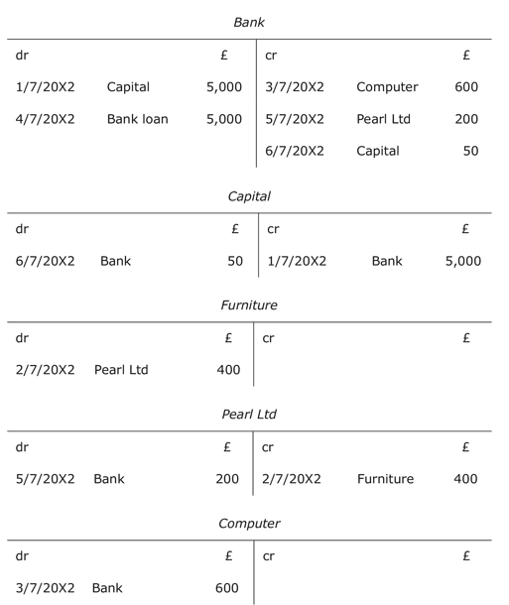
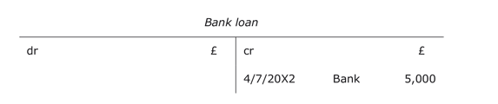

Slide 41
What is the procedure for balancing off accounts?
What is the procedure for balancing off accounts?
Accounts are straightforward to balance off if they consist of only one type of entry, i.e. only debit entries or only credit entries. In this case, all the account entries are simply added up to get the balance on the account. If, for instance, a bank account has three debit entries of £50 each, then the balance on the account is a debit balance of £150. However, when accounts consist of both debit and credit entries, the following procedure should be used to balance off these accounts:
Add up the amounts on each side of the account to find the totals.
Enter the larger figure as the total for both the debit and credit sides.
For the side that does not add up to this total, calculate the figure that makes it add up by deducting the smaller from the larger amount. Enter this figure so that the total adds up, and call it the balance carried down. This is usually abbreviated as Balance c/d.
Enter the balance brought down (abbreviated as Balance b/d) on the opposite side below the total figure. (The balance brought down is usually dated one day later than the balance carried down as one period has closed and another one has started.)
Using the rules above we can now balance off all of Edgar Edwards’ nominal ledger accounts starting with the bank account.

Slide 42
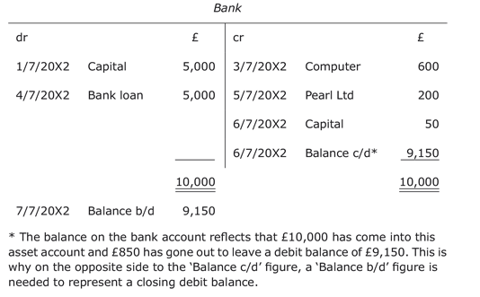
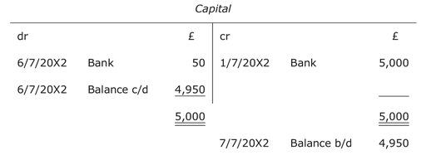
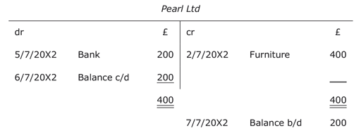
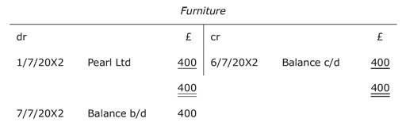

Slide 43
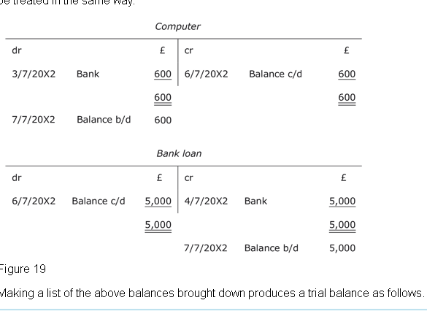

Slide 44
Edgar Edwards Trial Balance as at 6 July 20X2
 | Debit | Credit
 | $ | $
Bank | 9150
Capital |  | 4950
Furniture | 400
Pearl ltd( creditor) |  | 200
Computer | 600
Bank Loan |  | 5000
Total | 10150 | 10150

Slide 45
From the trial balance prepare balance sheet and income statements. Take the balance from the asset , expense , liability, equity and the revenue accounts from debits and credit balances and prepare the balance sheet and income statement.

